Slide 1
PRAM Algorithms
Ram Krishna Dahal
Asst. Professor
Central Department of computer science and IT, TU

Slide 2
Parallel Random Access Machine (PRAM)
Collection of numbered processors
Accessing shared memory cells
Each processor could have local memory (registers)
Each processor can access any shared memory cell in unit time
Input stored in shared memory cells, output also needs to be stored in shared memory

Slide 3
Parallel Random Access Machine (PRAM)
PRAM instructions execute in 3-phase cycles
Read (if any) from a shared memory cell
Local computation (if any)
Write (if any) to a shared memory cell
Processors execute these 3-phase PRAM instructions synchronously

Slide 4
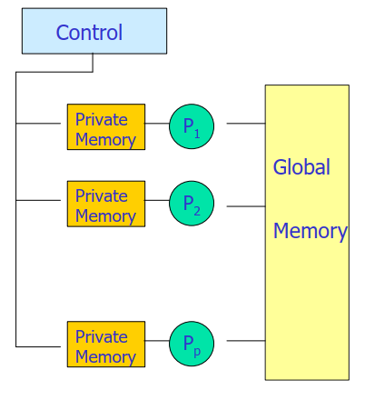
Parallel Random Access Machine (PRAM)

Slide 5
Shared Memory Access Conflicts
Different variations:
Exclusive Read Exclusive Write (EREW) PRAM: no two processors are allowed to read or write the same shared memory cell simultaneously
Concurrent Read Exclusive Write (CREW): simultaneous read allowed, but only one processor can write
Concurrent Read Concurrent Write (CRCW)

Slide 6
Shared Memory Access Conflicts
Concurrent writes:
Priority CRCW: processors assigned fixed distinct priorities, highest priority wins
Arbitrary CRCW: one randomly chosen write wins
Common CRCW: all processors are allowed to complete write if and only if all the values to be written are equal

Slide 7
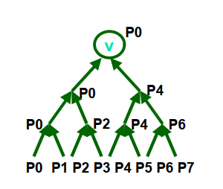
A Basic PRAM Algorithm
Let there be “n” processors and “2n” inputs
PRAM model: EREW
Construct a tournament where values are compared

Slide 8
A Basic PRAM Algorithm
Processor k is active in step j if (k % 2j) == 0 At each step: Compare two inputs, Take max of inputs, Write result into shared memory
Details: Need to know who is the “parent” and whether you are left or right child Write to appropriate input field

Slide 9

Definition of prefix computation
We are given an ordered set A of n elements and a binary associative operator ⊕.
$$A=\{a_{1},a_{2},a_{3},….,a_{n}\}$$
We have to compute the ordered set
$$\left\{a_{1},{(a}_{1}\text{⊕}a_{2}\right),\left({a_{1}\text{⊕}a_{2}\text{⊕}a}_{3}\right),……,{(a}_{1}\text{⊕}a_{2}\text{⊕}…a_{n})\}$$

Slide 10
An example of prefix computation
For example, if ⊕ is + and the input is the ordered set
{5, 3, -6, 2, 7, 10, -2, 8}
then the output is
{5, 8, 2, 4, 11, 21, 19, 27}
Prefix sum can be computed in O (n) time sequentially.

Slide 11
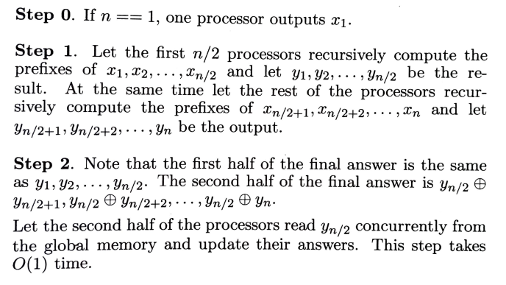
Prefix computation – pram algorithm in o(logn)

Slide 12
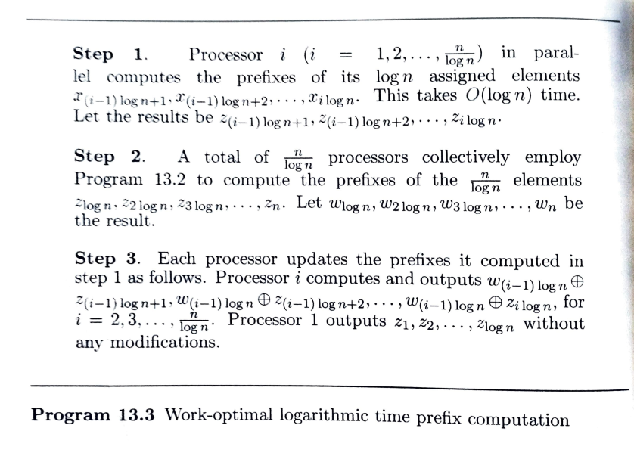

Slide 13
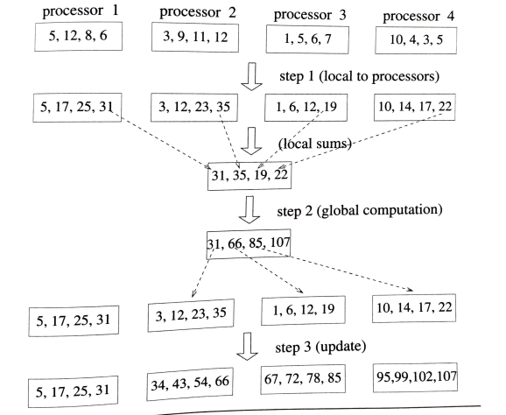
Prefix computation an example

Slide 14
List ranking
Given a single linked list L with n objects, compute, for each object in L, its distance from the end of the list.
Formally: suppose next is the pointer field Rank[i] = 0 if next[i] = nil Rank[i] =Rank[next[i]]+1 if next[i] != nil
Serial algorithm: O(n)

Slide 15
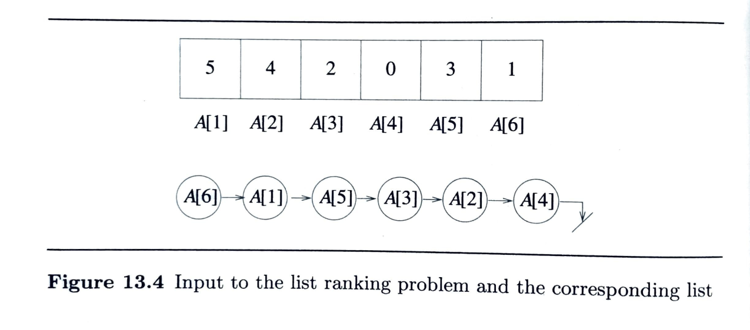

Slide 16
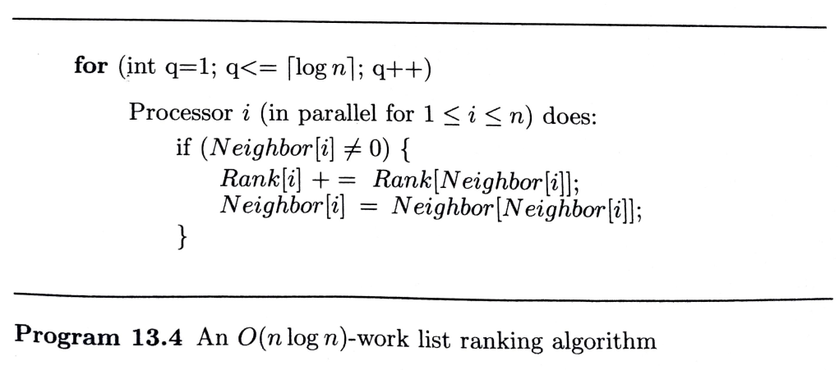

Slide 17
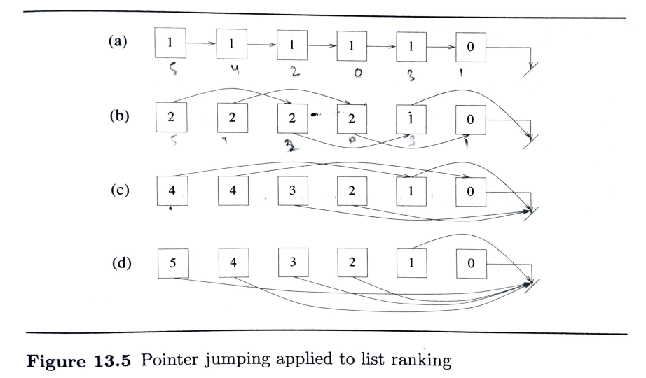
Deterministic list ranking – pointer jumping

Slide 18
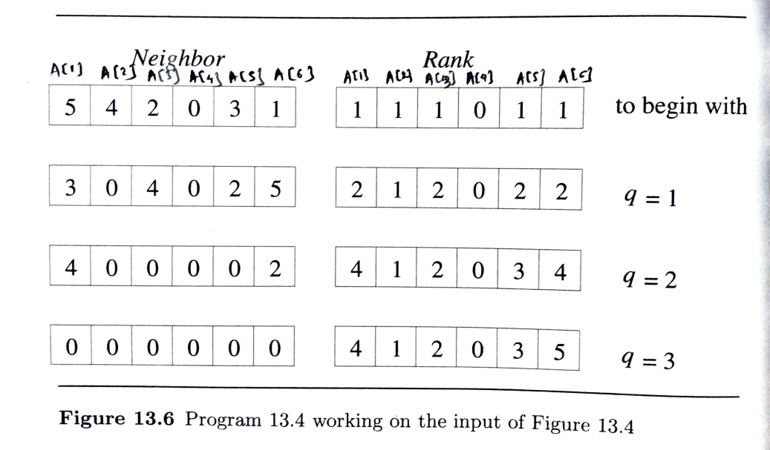
List ranking pram algorithm

Slide 19
Analysis
Total running time: O(log n)
Total work : n * O(log n) = O(n log n)
Sequential Algorithm : O(n)
Speed up= O(n)/ O(log n)= O(n/log n)
Efficiency = O(n)/ O(n log n)= 1/log n It is not work optimal!

Slide 20
Maximum selection with n² processors
Problem : Given n numbers, x1, x2, …, xn. Find the largest number.
Algorithm : CRCW algorithm; use n² CPUs; assume all numbers are distinct Step 1: For each CPU_{i,j} (for each 1 <= i,j<= n) in parallel : M_{i,j} = 1 if x_{i} < x_{j}; otherwise, 0 Step 2: For each row, use n CPUs to compute OR of n elements Step 3: (cont. from step 2) If ith row is 0, return x_{i}.

Slide 21
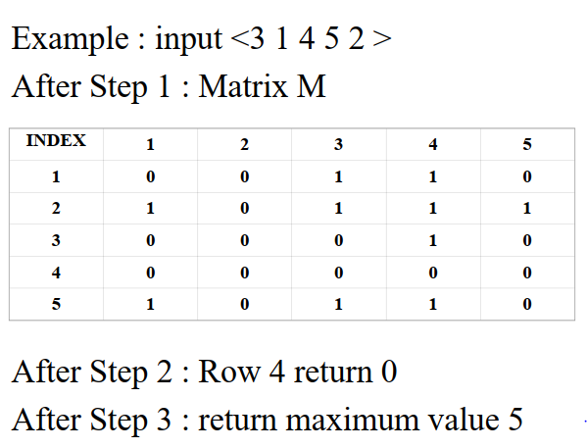

Slide 22
analysis
Total running time : O(1)
Total work : n² * O(1) = O(n²)
Sequential Algorithm : O(n) It is not work optimal!

Slide 23

Finding Maximum with n processors
Assume n is always a perfect square, i.e. k² = n (or k = n^{1/2})
If this is not true, take the smallest k such that k² $≥$ n
Step 1: If n = 1, return x1
Step 2: Partition n elements & n processors into k groups, say, G₁, G₂, …, G_{k} (assume k² = n). In parallel, call the algorithm recursively to find maximum element m_{i} of each group G_{i}
Step 3: Use previous algorithm with n CPUs to find the maximum of m₁, m₂, …, m_{k}

Slide 24
Analysis
This algorithm uses divide and conquer strategy In step 2, each sub problem has size k or n^{1/2} (n^{1/2} processors & n^{1/2} elements) In step 3, the running time is O(1)
WLOG, we assume that n = 2 and T(2) = O(1).
The total running time T(n) satisfy the recurrence
T(n) = T(n^{1/2}) + O(1)
T(2) = O(1)
which solves to T(n) = (log log n)

Slide 25
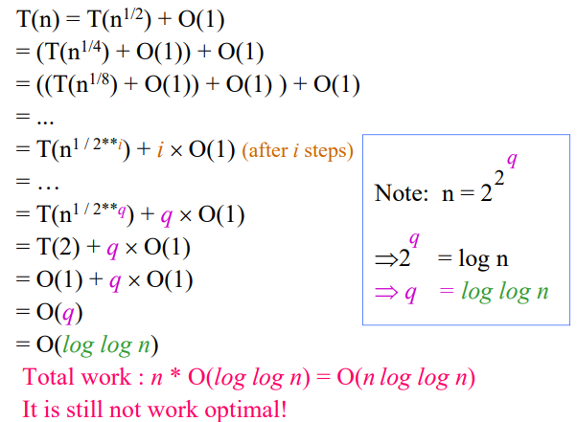

Slide 26
Merging
Problem : Given 2 sorted sequences X₁= k₁, k₂, …, k_{m} and X₂ = k_{m+1}, k_{m+2}, …, k_{2m}.
Assume each sequence has m distinct elements, and m is an integral power of 2.
The goal: to produce a sorted sequence of 2m elements.
Best sequential algorithm is O(m)

Slide 27

Merging
For each k_{j} $∈$X₁, we know that it is the rank #j element in X₁. We allocate a single processor to perform a binary search on X₂ and figure out q (the number of elements in X₂ that are less than k_{j} ). Then we know that k_{j} is the rank #(j+q) element in X₁$U$X₂.
For each element in X₂, a similar procedure can be used to compute its rank in X₁$U$X₂.
We can use 2m processors, one for each element. An overall rank can be found for each element using binary search in O(log m) time. Merging can be done in O(log m) time.
It is not work optimal! ???

Slide 28
Odd-Even Merge – using 2m processors
Step 1: If m=1, merge two sequence with 1 comparison
Step 2: Partition X₁ into their odd and even parts, i.e. X₁ ^{odd} =k₁, k₃, k₅ …, k_{m-1} and X₁ ^{even} = k₂, k₄, …, k_{m} Similarly, partition X₂ into X₂ ^{odd} and X₂ ^{even}
Step 3: Recursively merge X₁ ^{odd} , X₂ ^{odd} (and X₁ ^{even} , X₂ ^{even} ) using m processors. Let L₁ = u₁, u₂, …, u_{m} (L₂ = u_{m+1}, u_{m+2}, …, u_{2m}) be the result.
Step 4: Form a sequence L = u₁, u_{m+1}, u₂, u_{m+2}, u₃, u_{m+3}, …, u_{m}, u_{2m} Compare every pair (u_{m+i}, u_{1+i}), i.e. (u_{m+1}, u₂), (u_{m+2}, u₃), … Interchange elements if they are out of order. Output the resultant sequence.

Slide 29
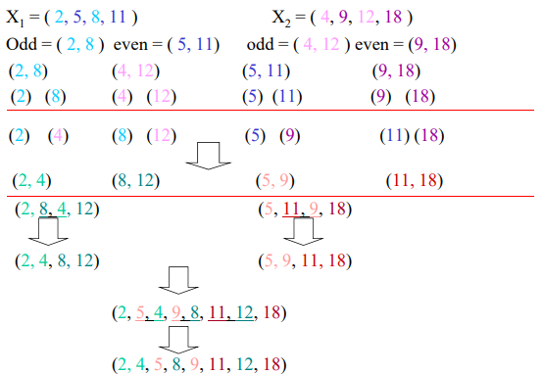
Example with m=4

Slide 30
Odd Even Merge Sort
Step 1 : If n <= 1 return X
Step 2 : Use n CPUs to partition input X of n elements into 2 lists, X₁ and X₂. Each with n/2 elements
Step 3: Use n/2 CPUs to sort X₁ recursively and n/2 CPUs to sort X₂ recursively. Let X₁ * and X₂ * be the result sorted lists.
Step 4: Use Odd-Even merge to merge two sorted lists using n CPUs.

Slide 31
Analysis
T(n) = O(1) + T(n/2) + O(log n)
= log(n) + log(n/2) + log(n/4) + … + log(n/2i ) ; i = log n
= log(n) + [log(n)–log 2] + [log(n)–log 4] +…+ [log(n)– log(n)]
<= log(n) * log(n)
T(n) = O(log² n)
Total work O(n log² n)
It is not work optimal

